Slide 1

What Does Splunk Do?

Slide 2

Machine Data?
Notes:
you must be aware of the exponential growth in machine data over the last decade.
It was partly because of the growing number of machines in the IT infrastructure and partly because of the increased use of IoT devices.
This machine data has a lot of valuable information
drive efficiency, productivity and visibility for the business. Splunk was founded in 2003 for one purpose:
To Make Sense Of Machine Generated Log Data and since then the demand for Splunk skill is increasing.
Now imagine if you were a SysAdmin,
Now imagine if you were a SysAdmin trying to figure out what went wrong in your system’s hardware and you stumble upon logs
Complex to understand
In an unstructured format
Not suitable for making analysis / visualization

Slide 3
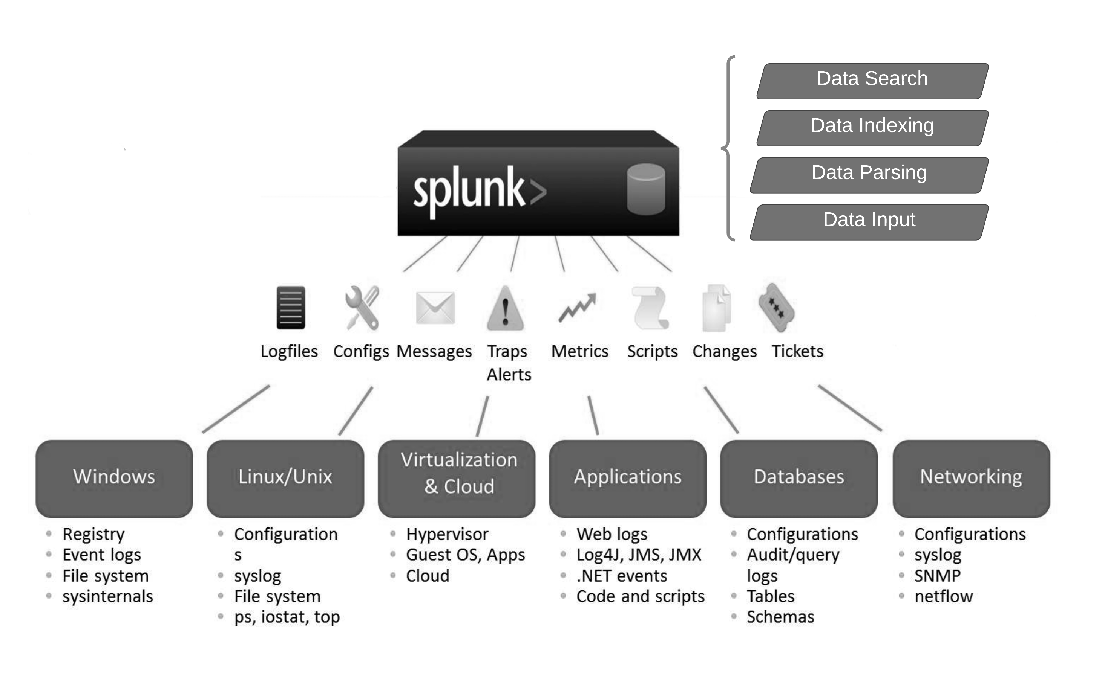
Notes:
Now imagine if you were a SysAdmin,
Complex to understand
In an unstructured format
Not suitable for making analysis / visualization
Your input data can be in any format for e.g. .csv, or json or other formats
Look at the below image to get an idea of how machine data looks.

Slide 4

Splunk in Real World!
Notes:
I am going to tell you how Bosch used Splunk for data analytics.
They collected the healthcare data from the remotely located patients using IoT devices(sensors).
Splunk would process this data
any abnormal activity would be reported to the doctor and patient via the patient interface

Slide 5

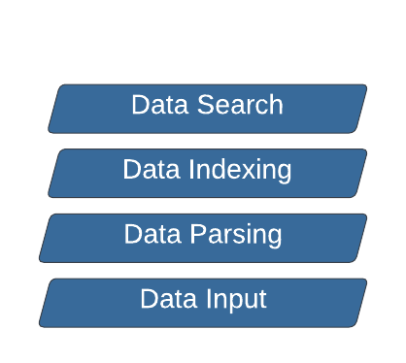
So what does Splunk?
Notes:
Splunk is a software platform to search, analyze and visualize the machine-generated data gathered
from the websites, applications, sensors, devices etc. which make up your IT infrastructure and business.
Splunk is a distributed system that ingests, processes and indexes log data. Splunk processes data in three stages:
Data Input – Splunk ingests the raw data stream from the source, breaks it into 64K blocks, and adds metadata keys, including hostname, source, character encoding, and the index the data should be stored in.
Data Storage – Splunk parses log data, by breaking it into lines, identifying timestamps, creating individual events and annotating them with metadata keys. It then transforms event data using transformation rules defined by the operator. Finally, Splunk writes the parsed events to disk, pointing to them from an index file which enables fast search across huge data volumes.
Data Search – at this stage Splunk enables users to query, view and use the event data. Based on the user’s reporting needs, it creates objects like reports, dashboards and alerts.

Slide 6
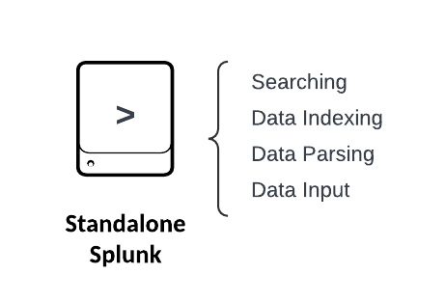
Splunk Architecture ?
The search head provides the UI to users so they can use it to interact with Splunk. It allows users to search and query Splunk data, and interfaces with indexers to gain access to the specific data they request.
Data parsing and storage – Splunk parses log data, by breaking it into lines, identifying timestamps, creating individual events and annotating them with metadata keys
Data Input – Splunk ingests the raw data stream from any device breaks it into 64K blocks, and adds metadata keys, including hostname, source, character encoding, and the index the data should be stored in
Notes:
As in my previous slide,
Splunk is a distributed system that ingests, processes and indexes log data.
Splunk processes data in three stages:
Data Input – Splunk ingests the raw data stream from any devicebreaks it into 64K blocks, and adds metadata keys, including hostname, source, character encoding, and the index the data should be stored in.
, for the sole purpose of this rchitectue presented here, splunk acts as a standalone which does all together
3. Data Storage – Splunk parses log data, by breaking it into lines, identifying timestamps, creating individual events and annotating them with metadata keys.
It then transforms event data using transformation rules, we will talk about this in subsequent sections .
Finally, Splunk writes the parsed events to disk, pointing to them from an index file which enables fast search across huge data volumes.
Data Search – at this stage Splunk enables users to query, view and use the event data. Based on the user’s reporting needs,
it creates objects like reports, dashboards and alerts.

Slide 7
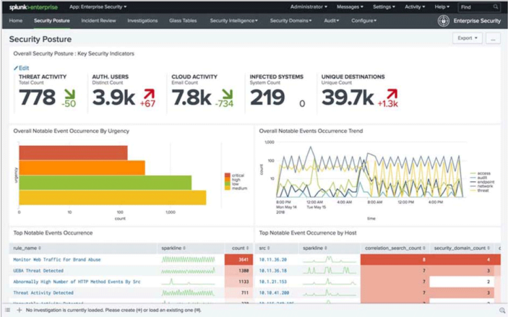

Slide 8
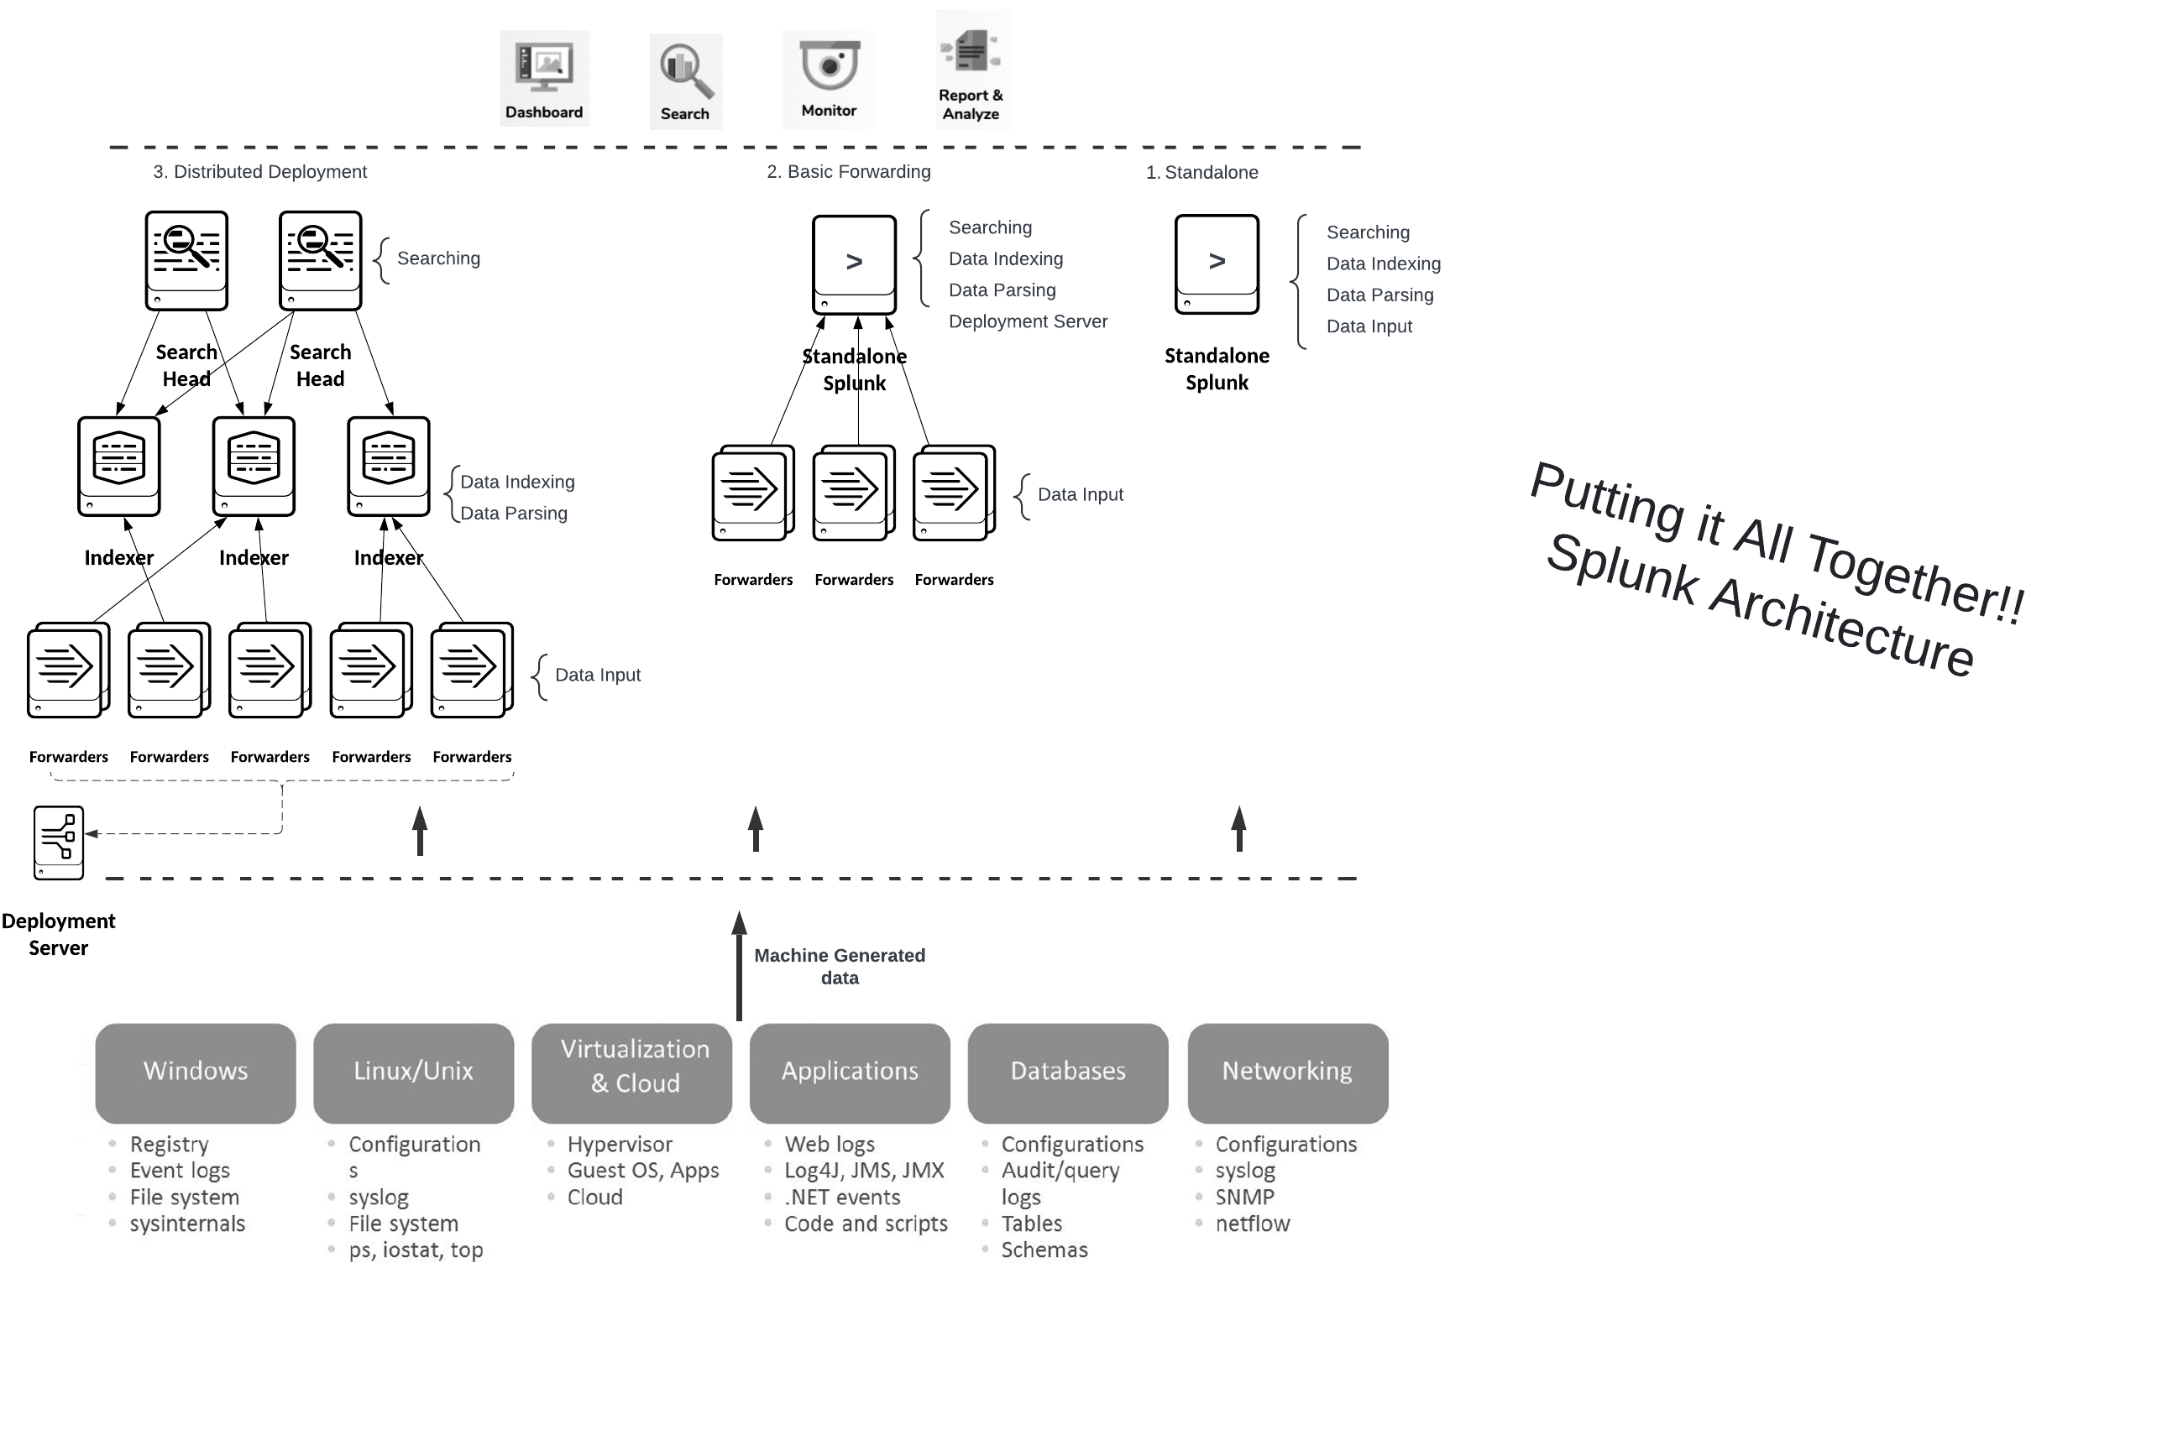
as best practice, we would deploy the forwarders ( data collection part ) to the desired end machines to collect the logs from
Universal Forwarder – forwards the raw data without any prior treatment
In real world scenario and as best practice, we would deploy the search head component to a dedicated machine to perform high intensity dedicated search queries functionality
Note: all components get installed from the same Splunk package
it is the configuration which changes the Splunk behavior!!

Slide 9
Splunk Architecture: Data Flow, Components and Topologies
Splunk is a distributed system that ingests, processes and indexes log data. Splunk processes data in three stages:
Data Input – Splunk ingests the raw data stream from the source, breaks it into 64K blocks, and adds metadata keys, including hostname, source, character encoding, and the index the data should be stored in.
Data Storage – Splunk parses log data, by breaking it into lines, identifying timestamps, creating individual events and annotating them with metadata keys. It then transforms event data using transformation rules defined by the operator. Finally, Splunk writes the parsed events to disk, pointing to them from an index file which enables fast search across huge data volumes.
Data Search – at this stage Splunk enables users to query, view and use the event data. Based on the user’s reporting needs, it creates objects like reports, dashboards and alerts.

Slide 10
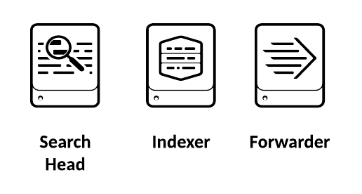
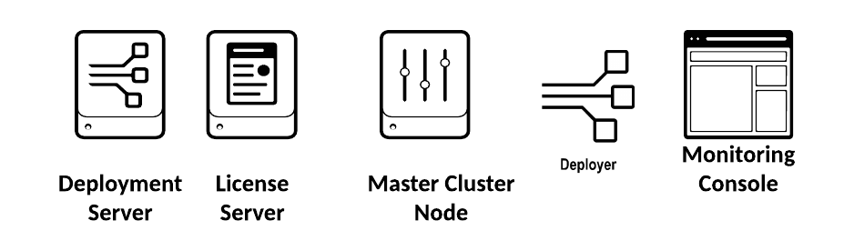
Splunk Components at a glance!
Processing Components: Handle the data
Management components: support the activities of the processing components

Slide 11

Splunk Forwarder
The forwarder is an agent you deploy on IT systems.
collects logs and sends them to another Splunk Enterprise instance
Very Fast, requires less resources on the host and minimal footprint
Data is not cooked ( unparsed )
No UI
No Python support.
Regarded as the best data collection method
The most common way to get data in
No license needed

Slide 12
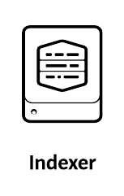
Splunk Indexer
The indexer transforms data into events (unless it was received pre-processed from a heavy forwarder)
stores it to disk and adds it to an index, enabling searchability.
The indexer creates the following files, separating them into directories called buckets:
Compressed raw data
Indexes pointing to raw data (.TSIDX files)
Metadata files ( host, source and source type )
The indexer performs generic event processing on log data

Slide 13

Splunk Heavy Forwarder
full Splunk Enterprise instance that can index, search, and change data as well as forward it
The major difference between Splunk Universal Forwarder and Splunk Heavy Forwarder is PARSING & INDEXING, note that a Universal Forwarder has no Python packages
Note that when the data comes from a Heavy Forwarder, indexers do NOT parse the data again.
Heavy Forwarders are also used to run Splunk add-ons that receive data from external sources
Data forwarded are parsed ( cooked )
Larger footprint with respect to UFs
Requires a license
- Splunk HTTP Event collector
- Splunk DBConnect

Slide 14

Splunk Search Head
The search head provides the UI for users to submit searches via SPL
It allows users to search and query Splunk data.
Splunk provides a distributed search architecture, which allows you to scale up to handle large data volumes,
the search head sends search requests to a group of indexers

Slide 15
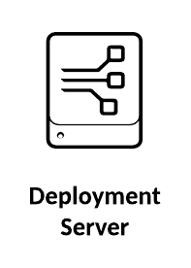

Splunk Deployment Server
Regarded as centralized configuration manager
Manage and push configurations to any number of Splunk Enterprise instances.
Users interface with the forwarder Management
Deployment Clients (UFs, HFs for example ) are remotely managed by this instance
Apps and configurations files are maintained under the “deployment Apps”
Deployment Clients “phone home” at intervals back
to the deployment server

Slide 16

License Master
Acts as a central license repository for Splunk Enterprise licenses.
you can define license Pools and stacks

Slide 17
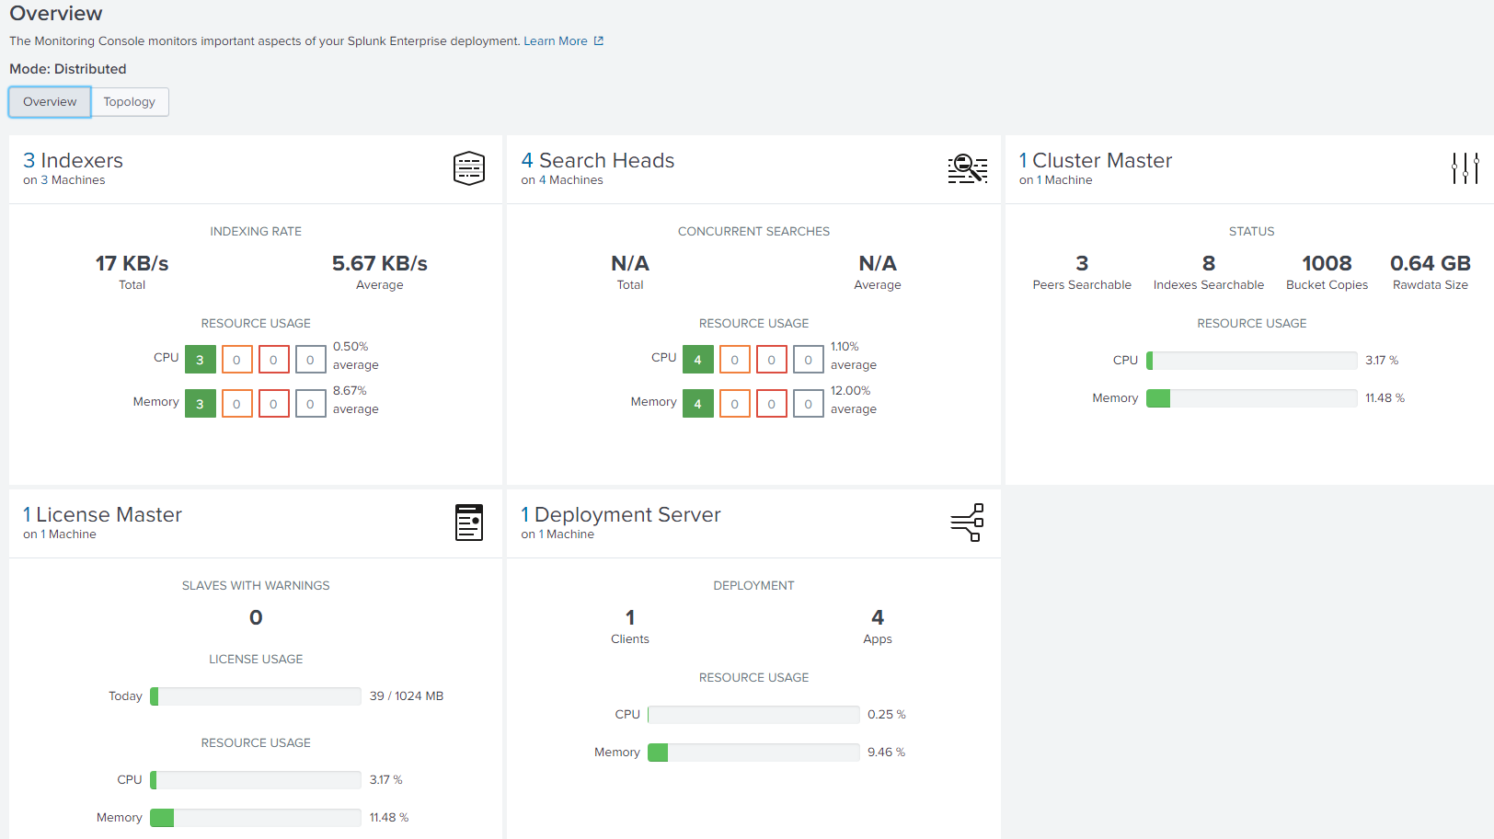

Monitoring Console
The Monitoring Console is a tool for viewing detailed topology and performance information for your Splunk Enterprise deployment.
You can access the Monitoring Console (you must have admin privileges) by clicking the Monitoring Console icon in Settings on the node where the MC has been configured, which is usually (preferably) a Cluster Master(CM) with sufficient hardware resources

Slide 18
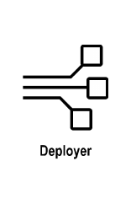
Splunk Deployer
The deployer is a Splunk Enterprise instance that you use to distribute apps and certain other configuration updates to search head cluster members. The set of updates that the deployer distributes is called the configuration bundle.

Slide 19
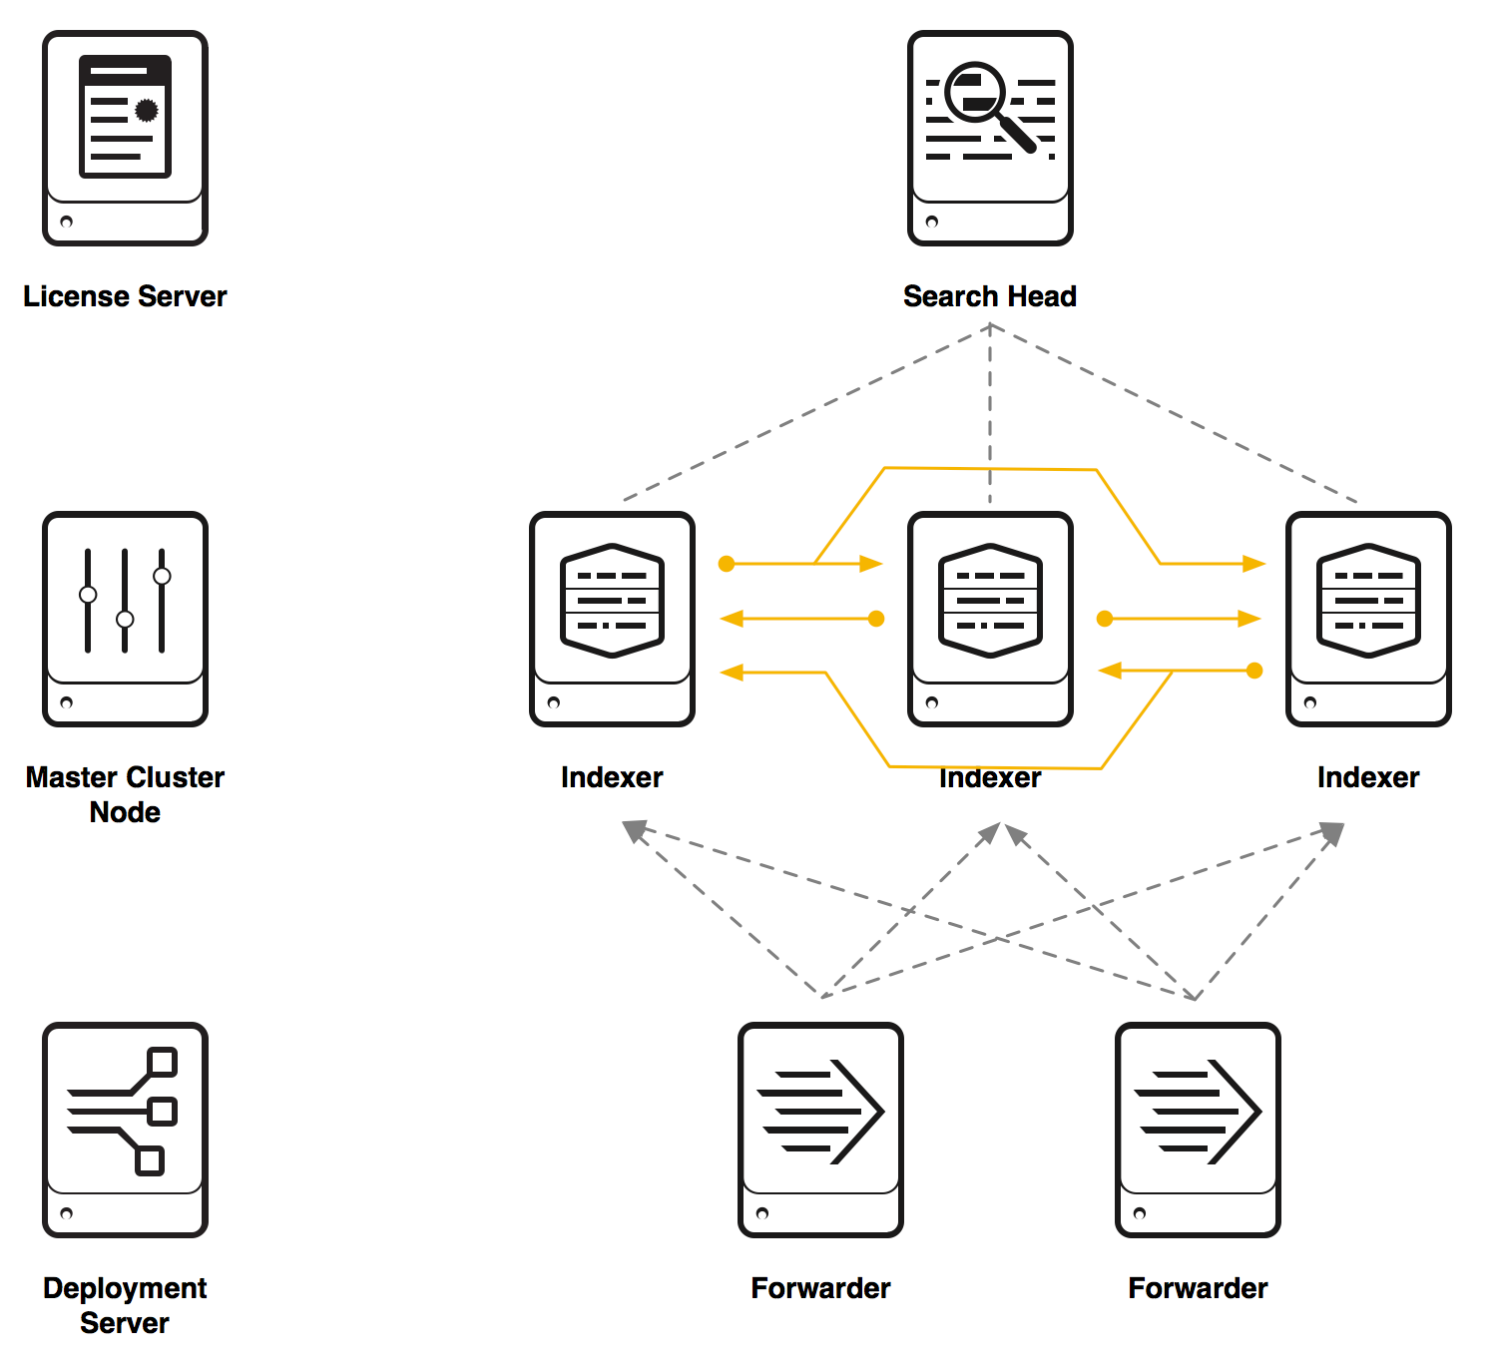
Splunk Cluster Master
Manages and regulates the functioning of indexers so that replicate external data, so that they maintain multiple copies of the data.
Indexer clusters provide high availability and disaster recovery.
Indexer clusters feature automatic failover from one indexer to the next.
This means that, if one or more indexers fail, incoming data continues to get indexed and indexed data continues to be searchable.

Slide 20
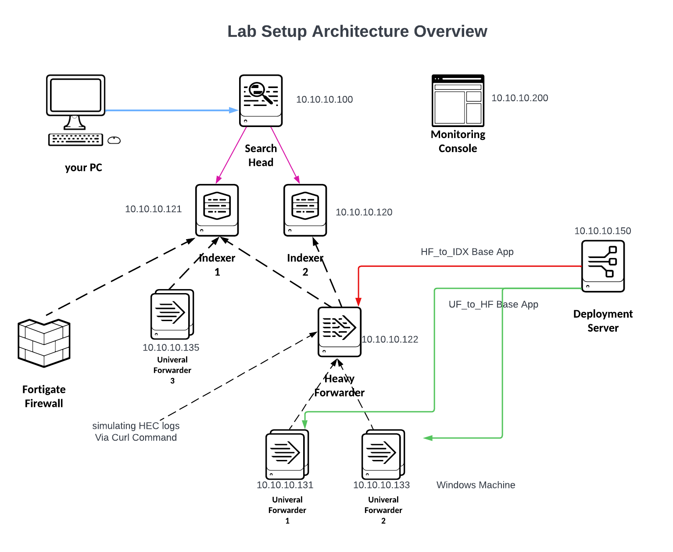

Slide 21
Splunk Installation
Install Splunk on Linux
Install Splunk on Windows

Slide 22
Splunk Installation Prerequisites
Identify Splunk Roles based on architecture requirement
Follow Splunk SVA Architecture
Follow reccomended Hardware specs
Identify desired Data to be ingested
Account / Best Practice to use non-root account
NTP
Network settings
allow Splunk ports through the Firewall

Slide 23
Splunk Web Navigation – Post Installation
Check the following via the web:
Server settings
Server control

Slide 24
Splunk health check – Post Installation
Linux Server reccomendations
(increase Ulimit Settings / Turn Off THP )
Check Splunk status via CLI
Enable boot start as Splunk will not start automatically at boot

Slide 25
Splunk Apps and Add-ons
Apps Extend splunk functionality
Can be created by anyone
What is the difference between apps and Add-ons ?

Slide 26
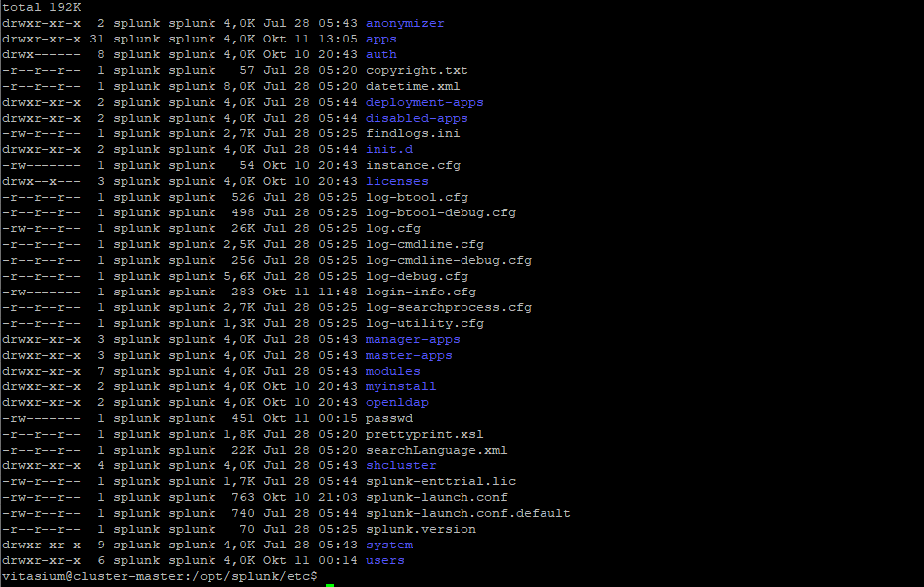
Splunk configuration files

Slide 27
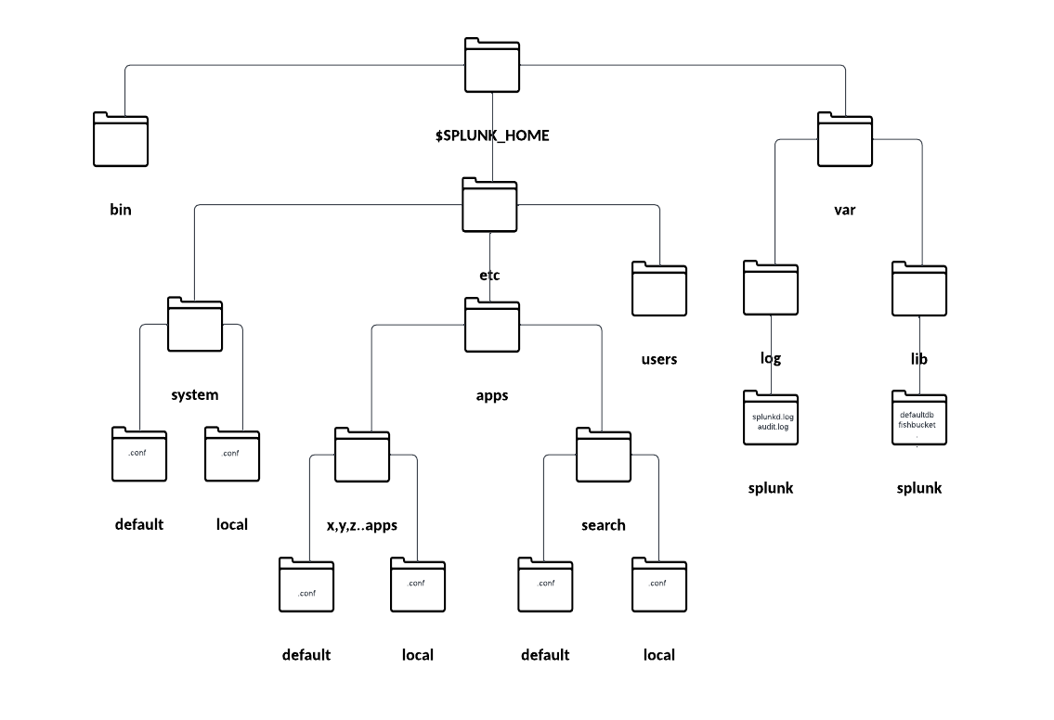

Splunk Directory Structure

Slide 28
Notes about Directory structure
“Default” is never to be changed / make conf modification under “local” directory as it superseads the default ( last resort )
Common used conf files are props.conf, inputs.conf, outputs.conf, server.conf, transforms.conf
.conf files are executed based on presedence
Splunk configurations has two contexts
Global context ( index time ) i.e indexing
User /app context ( Search time )
At Runtime it merges all of them and create a single inputs.conf of all existing files directory
When there is a conflict, ASCII takes precedence at app level.
https://docs.splunk.com/Documentation/Splunk/7.1.3/Indexer/Indextimeversussearchtime
https://docs.splunk.com/Documentation/Splunk/9.0.1/Admin/Wheretofindtheconfigurationfiles

Slide 29
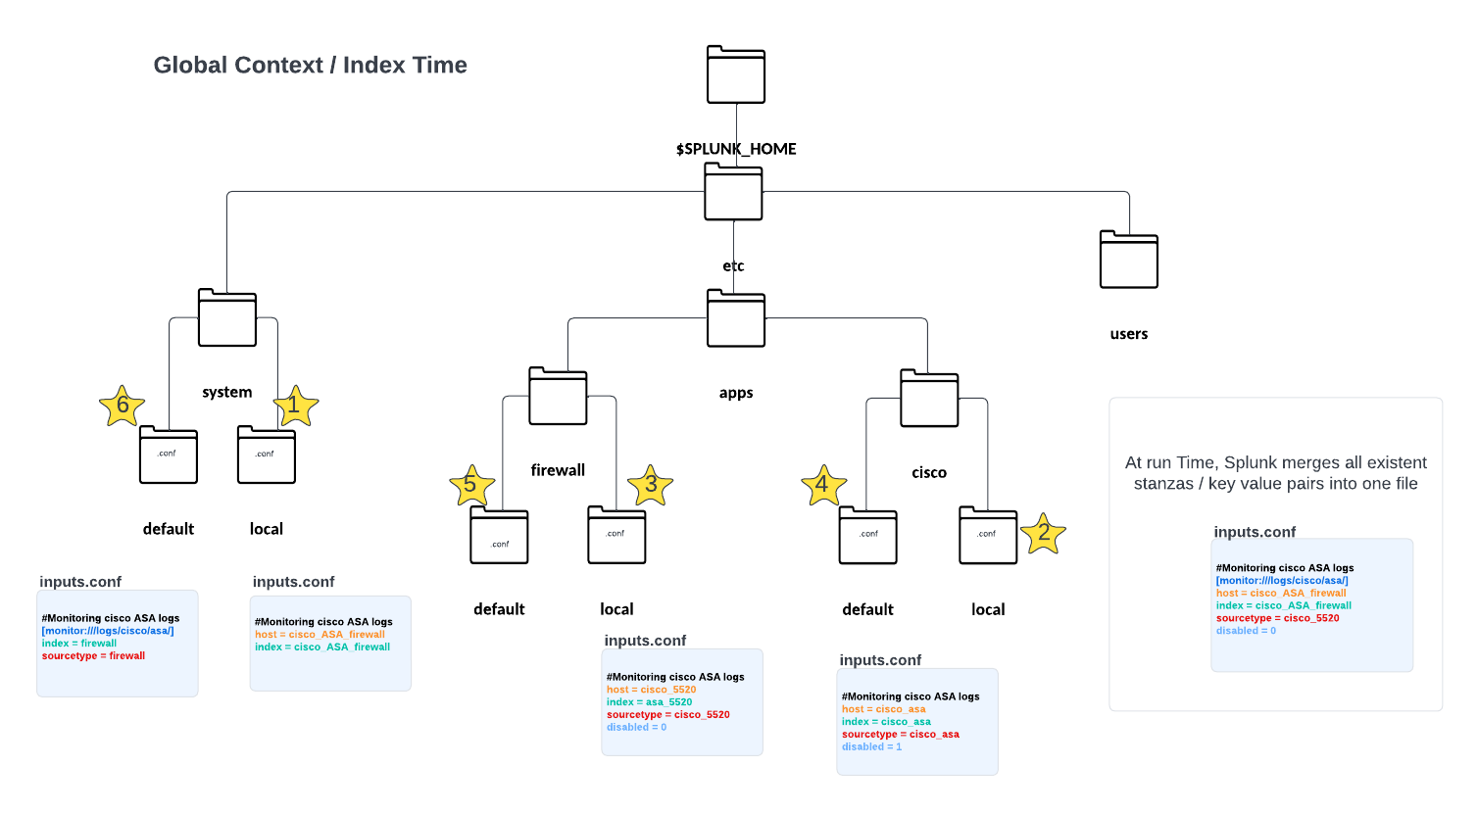

Configuration files are merged at run time
If there are any duplicate in stanzas across the different existent inputs.conf files, the highest precedence takes place
If there are no conflicts, then it will be added
Local beats default

Slide 30
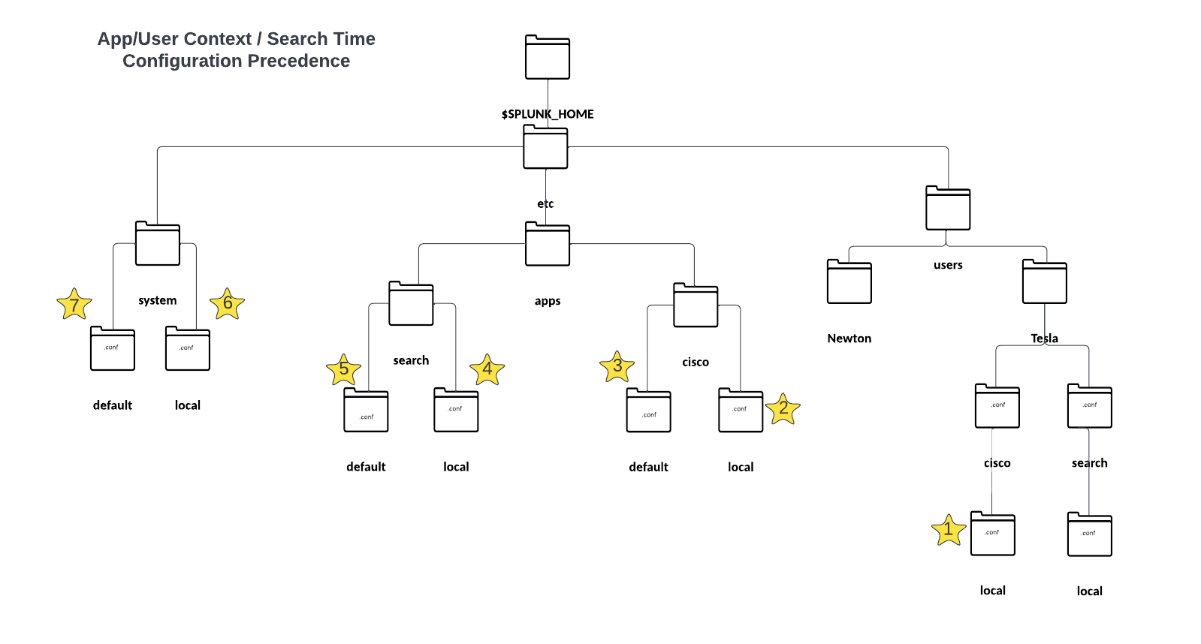

Slide 31
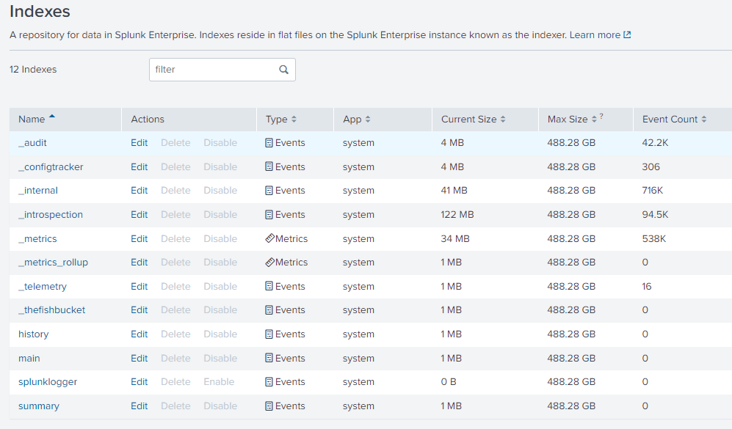

Splunk Indexes
what is an index? is simply a repository for the data. It is stored on an indexer
The indexed data can then be searched through a search app.
they are stored under /var/lib/splunk
Splunk preconfigured Indexes

Slide 32
Why create indexes and not one index ?
Fast search retrieval
Access Control, who access what!
Retention Policy based on data sources ( Firewalls, Security Logs, Audit, transactions..etc

Slide 33
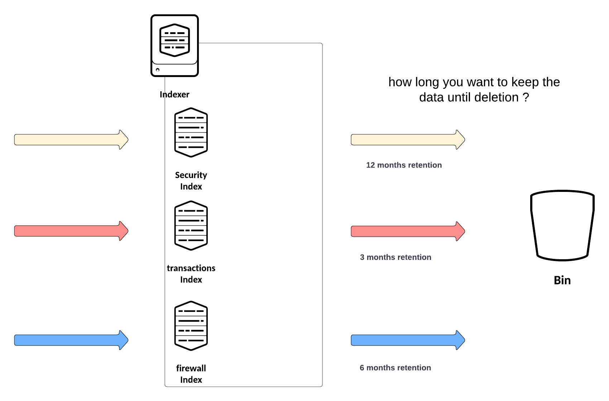
Why create indexes and not one index ?

Slide 34
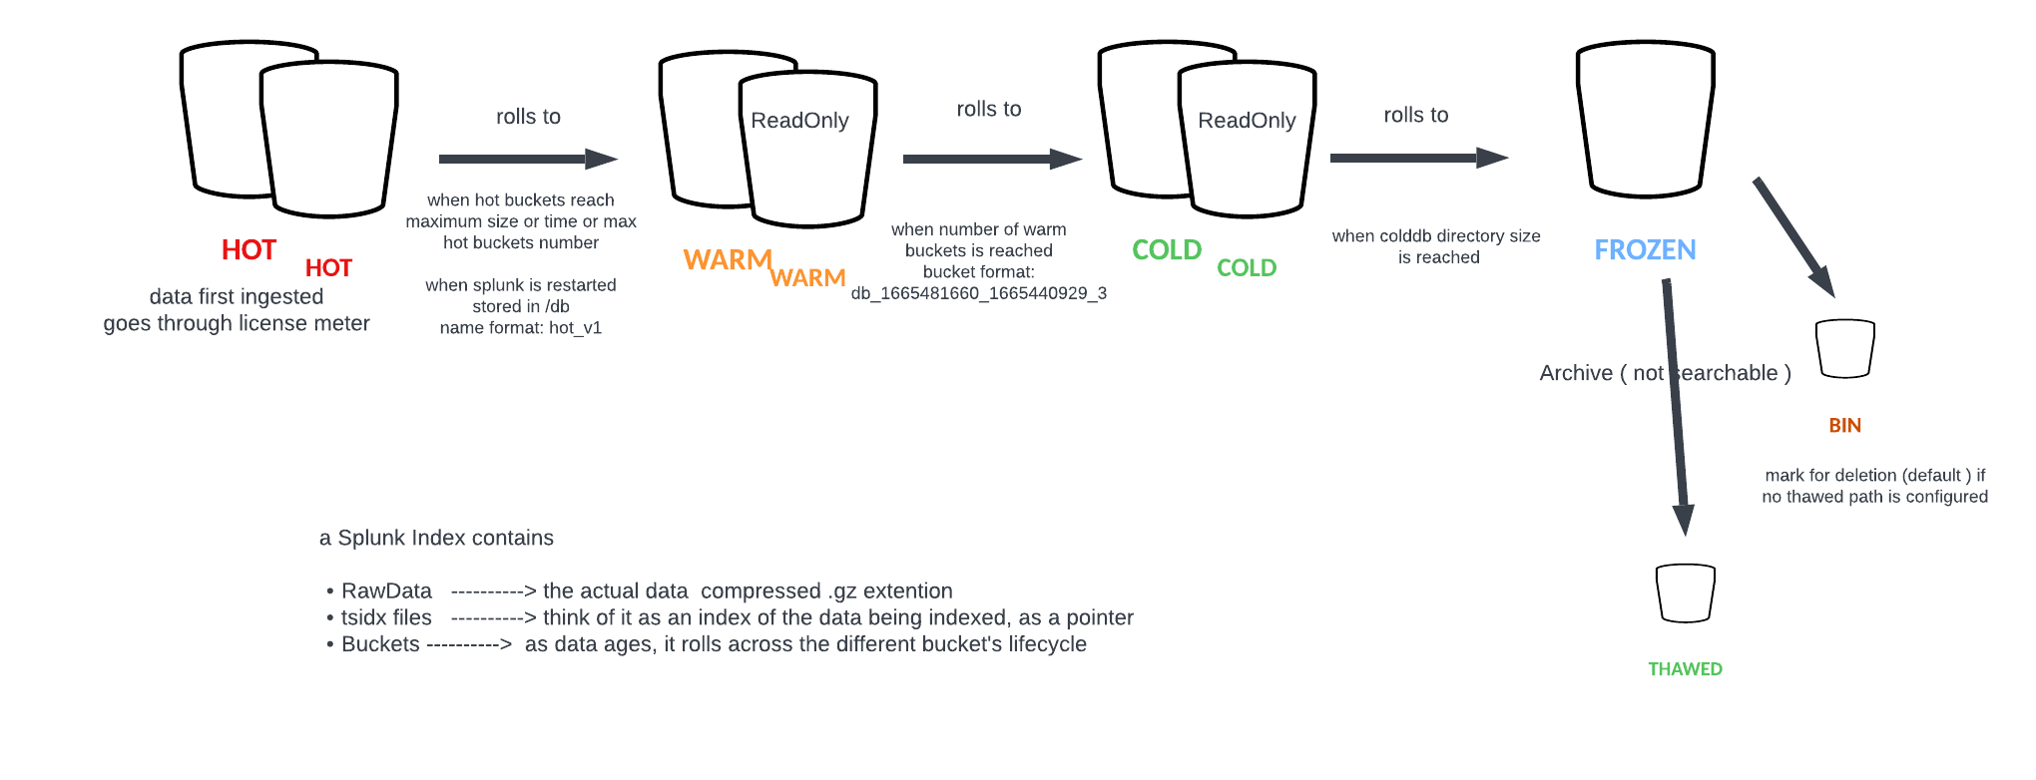


Index’s Structure ( buckets )

Slide 35
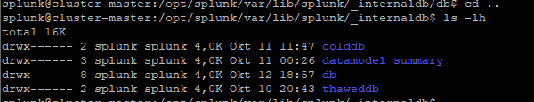
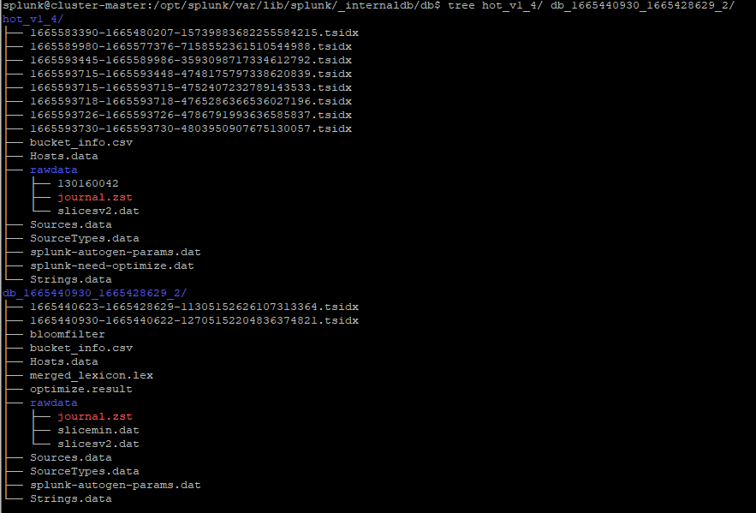
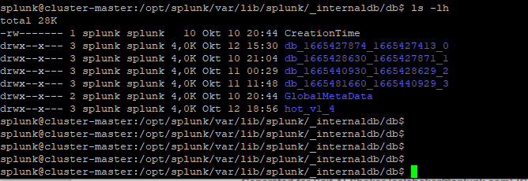
Index’s Structure ( buckets )

Slide 36
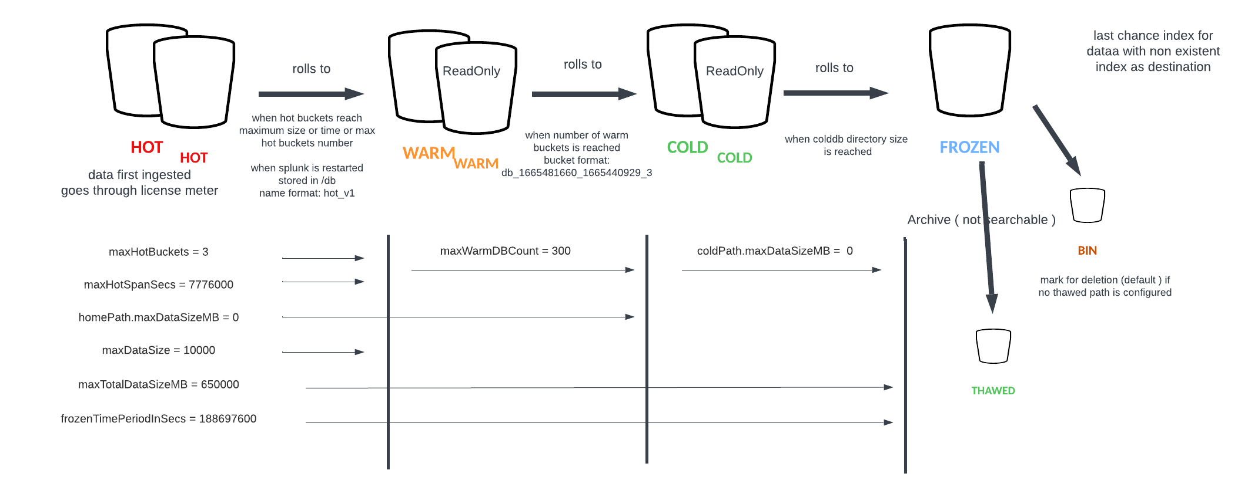
Bucket Life Cycle

Slide 37
Let’s Add our first Index!
Via the Web
Via CLI

Slide 38
Splunk Backup / Deletion
Backup the whole /var/lib/splunk directory
Settings configured under /etc directory like system/local, users, apps
Remember! Hot buckets cannot be backed up unless you stop splunk, so they will roll to warm
To move an index, stop “splunk” process then copy the index directory of your choice, then start splunk process again
Removing unwanted events already ingested in the “index”, by using the command “delete” appended to your desired events search query
Also you can run the “splunk clean” command, this will delete the entire index ( not recommended ) NOTE! If you don’t specify an index, all indexes will be deleted! Be cautious !

Slide 39
The Fishbucket Concept
It does exist with every splunk instance ( a forwarder or an indexer )
Think of the Fishbucket as a pointer ( point of reference ) as to how far Splunk has read into the file being monitored (in real life scenario, this usually happens on the forwarder side )
Command:
./splunk cmd btprobe -d $SPLUNK_HOME/opt/splunkforwarder/var/lib/splunk/fishbucket/splunk_private_db/ --file <THE_FILE_PATH_BEING MONITORED> --reset
Or
./splunk clean eventdata –index _thefishbucket
Stop splunk process, run the above, then start splunk process again.
You can achieve the above by deleting the /var/lib/splunk/fishbucket file with rm –r

Slide 40
Installing Splunk Forwarder
Data collection is achieved:
deploy the forwarder directly on the endpoint and configure the forwarder to monitor the desired files
Deploy the forwarder on a dedicated machine ( configure the inputs.conf to listen on a specific port ) and have the logs forwarded to it. Think of this forwarder instance as a syslog server
Deploy the forwarder to forward the logs to another forwarder ( Intermediate Forwarder )
In large scale deployments, we will use the deployment server to manage the Forwarders on the end machines
Useful commands:
./splunk list forward-server
./splunk display listen

Slide 41
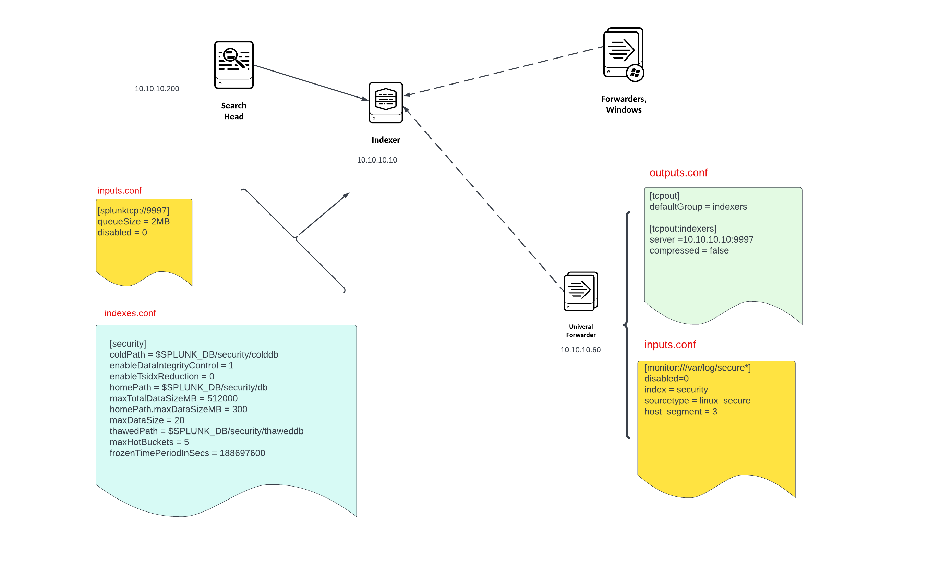
Splunk forwarder / Indexer configuration Lab Setup

Slide 42
Break 11.20

Slide 43
Distributed Search
The Search Head dispatches the queries to the indexers ( Search Peers )
Add the indexers ( search Peers ) to the Search Head by clicking on Settings →Distributed Search -> Search Peers and add a new Search Peer or you can also edit the distsearch.conf file under
SPLUNK_HOME/etc/system.local
In this case /opt/splunk/etc/system/local
[distributedSearch]
servers = https://INDEXER_IP_ADDRESS:8089
Search Head distributes what is called “Knolwedge Bundles” to the search peers which contain Knowledge Objects, and they are located under SPLUNK_HOME/var/run and SPLUNK_HOME/var/run/searchpeers for the Search Head and the Search Peer respectively. Knowledge objects are shared in clustered environment whereas dedicated search heads don’t.
In a distributed architecture where the Search peer is having performance issue, the search peer can be put in quarantine mode
Why multiple Search Heads? Mainly for access control, performance

Slide 44
Splunk Deployment Server – Splunk Enterprise Free Trial
Splunk Deployment Server – Standalone Splunk Enterprise

Slide 45
Why Integrate Splunk with LDAP
Local accounts are easy to set up, but difficult to manage
often corporate companies would have a directory service which is used for user management. Most commonly used approach is LDAP or commonly called AD authentication ( Active Directory )
We can use existing AD Configuration to add and manage/update users / Groups and assign those groups to Splunk roles.

Slide 46
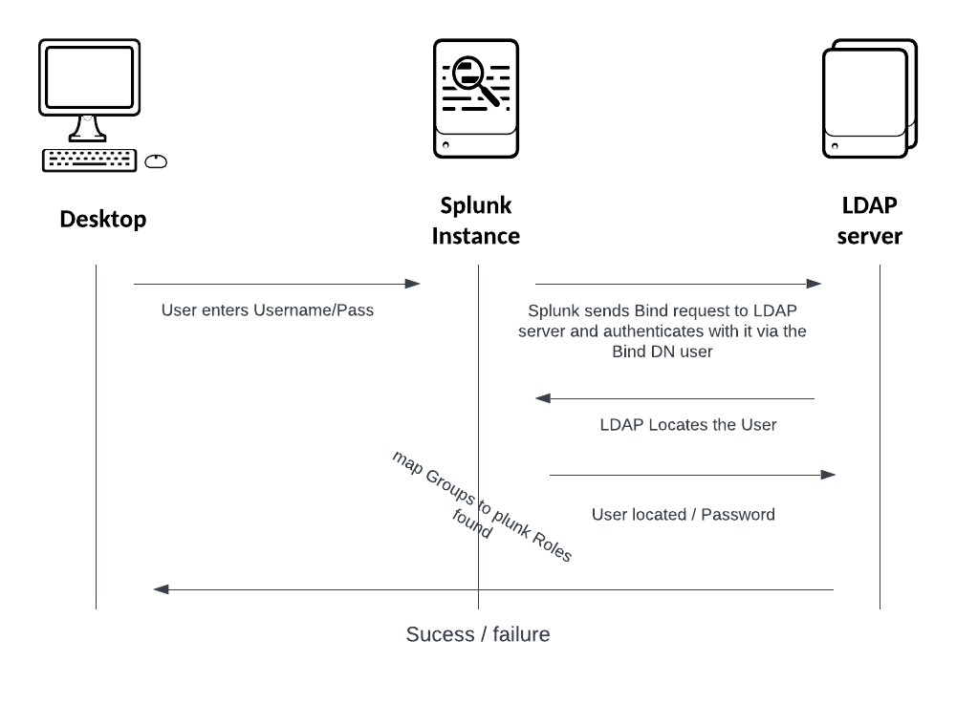
how does this work?
The most common LDAP use case is serving as a central location for storing authentication information, such as usernames and passwords. You can use the stored authentication information on various applications to validate users.
The LDAP is a standard protocol for accessing directory Services, it authenticates and authorizes users to their resources. The protocol authenticates users with a bind request that allows the user to communicate with an LDAP directory. To make LDAP queries, there must be an associated service account, or Bind DN, with permissions to access LDAP that exists. This will be the case for most LDAP environments, then map those groups in LDAP to Splunk Roles.
The user will need to have the ability to read LDAP information on all users and groups that need to log into Splunk.

Slide 47
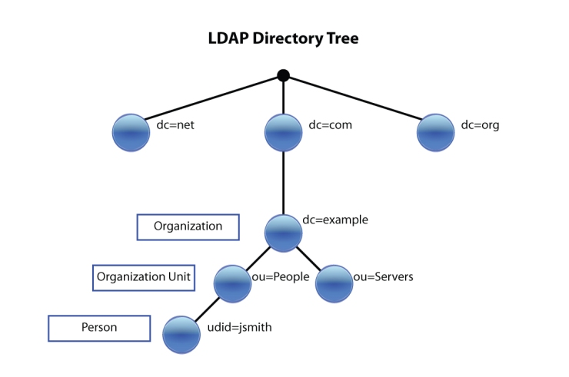
how does this work?
In its simplest form, an LDAP is a tree like structure

Slide 48
LDAP Configuration Prerequisites
The host that is running LDAP ( Like Active Directory )
The port where LDAP is running on this host (TCP/636 (SSL – Recommended) or TCP/389 (insecure)
Connection Order
A service account that has permission to make a bind request to the LDAP server (Bind DN) It is recommended you should not use default AD administrator account or your own AD login here. You should create a dedicate account for Splunk – no AD administrative privilege required on this account.
A password associated with the Bind DN user
The location of LDAP Users data in your LDAP tree structure (referred to the User Base DN)
The location of groups where Splunk will look for AD groups in LDAP (referred to the Group Base DN)

Slide 50
Integrate Splunk with LDAP
Via the Splunk Web
Create an LDAP Strategy
Map User Groups to a Splunk Role
By creating authentication.conf file as part of an App

Slide 51
https://docs.splunk.com/Splexicon:Tsidxfile#:~:text=tsidx%20file,-noun&text=A%20time%2Dseries%20index%20file,contents%20of%20an%20index%20bucket.
A time-series index file, also called an index file. A tsidx file associates each unique keyword in your data with location references to events, which are stored in a companion rawdata file. Together, the rawdata file and its related tsidx files make up the contents of an index bucket.
demo to show
Adding an index ( demo ) via the web, as well as via CLI
Then add data for illustration purposes
Manage indexes via the web ( illustration and explanation )
Explanation of the indexes.conf file

Slide 52
Data Collection Methodology
We can collect the data as input in many different ways
1. Monitoring files and Directories
(this could be locally or remotely or uploading files directly to splunk via the web for data analysis)
2. Receive syslog Logs on a port ( TCP / UDP ) sending syslog logs from a firewall to splunk UFs
3. Script Execution ( Modular Inputs)
4. Windows Logs ( win event Security, Registry, DNS, Active Directory, perfmon etc )
5. HTTP Event Collector (send data over HTTP/HTTPS requests)
Preferred method to configure the above is by directly editing the inputs.conf file

Slide 53
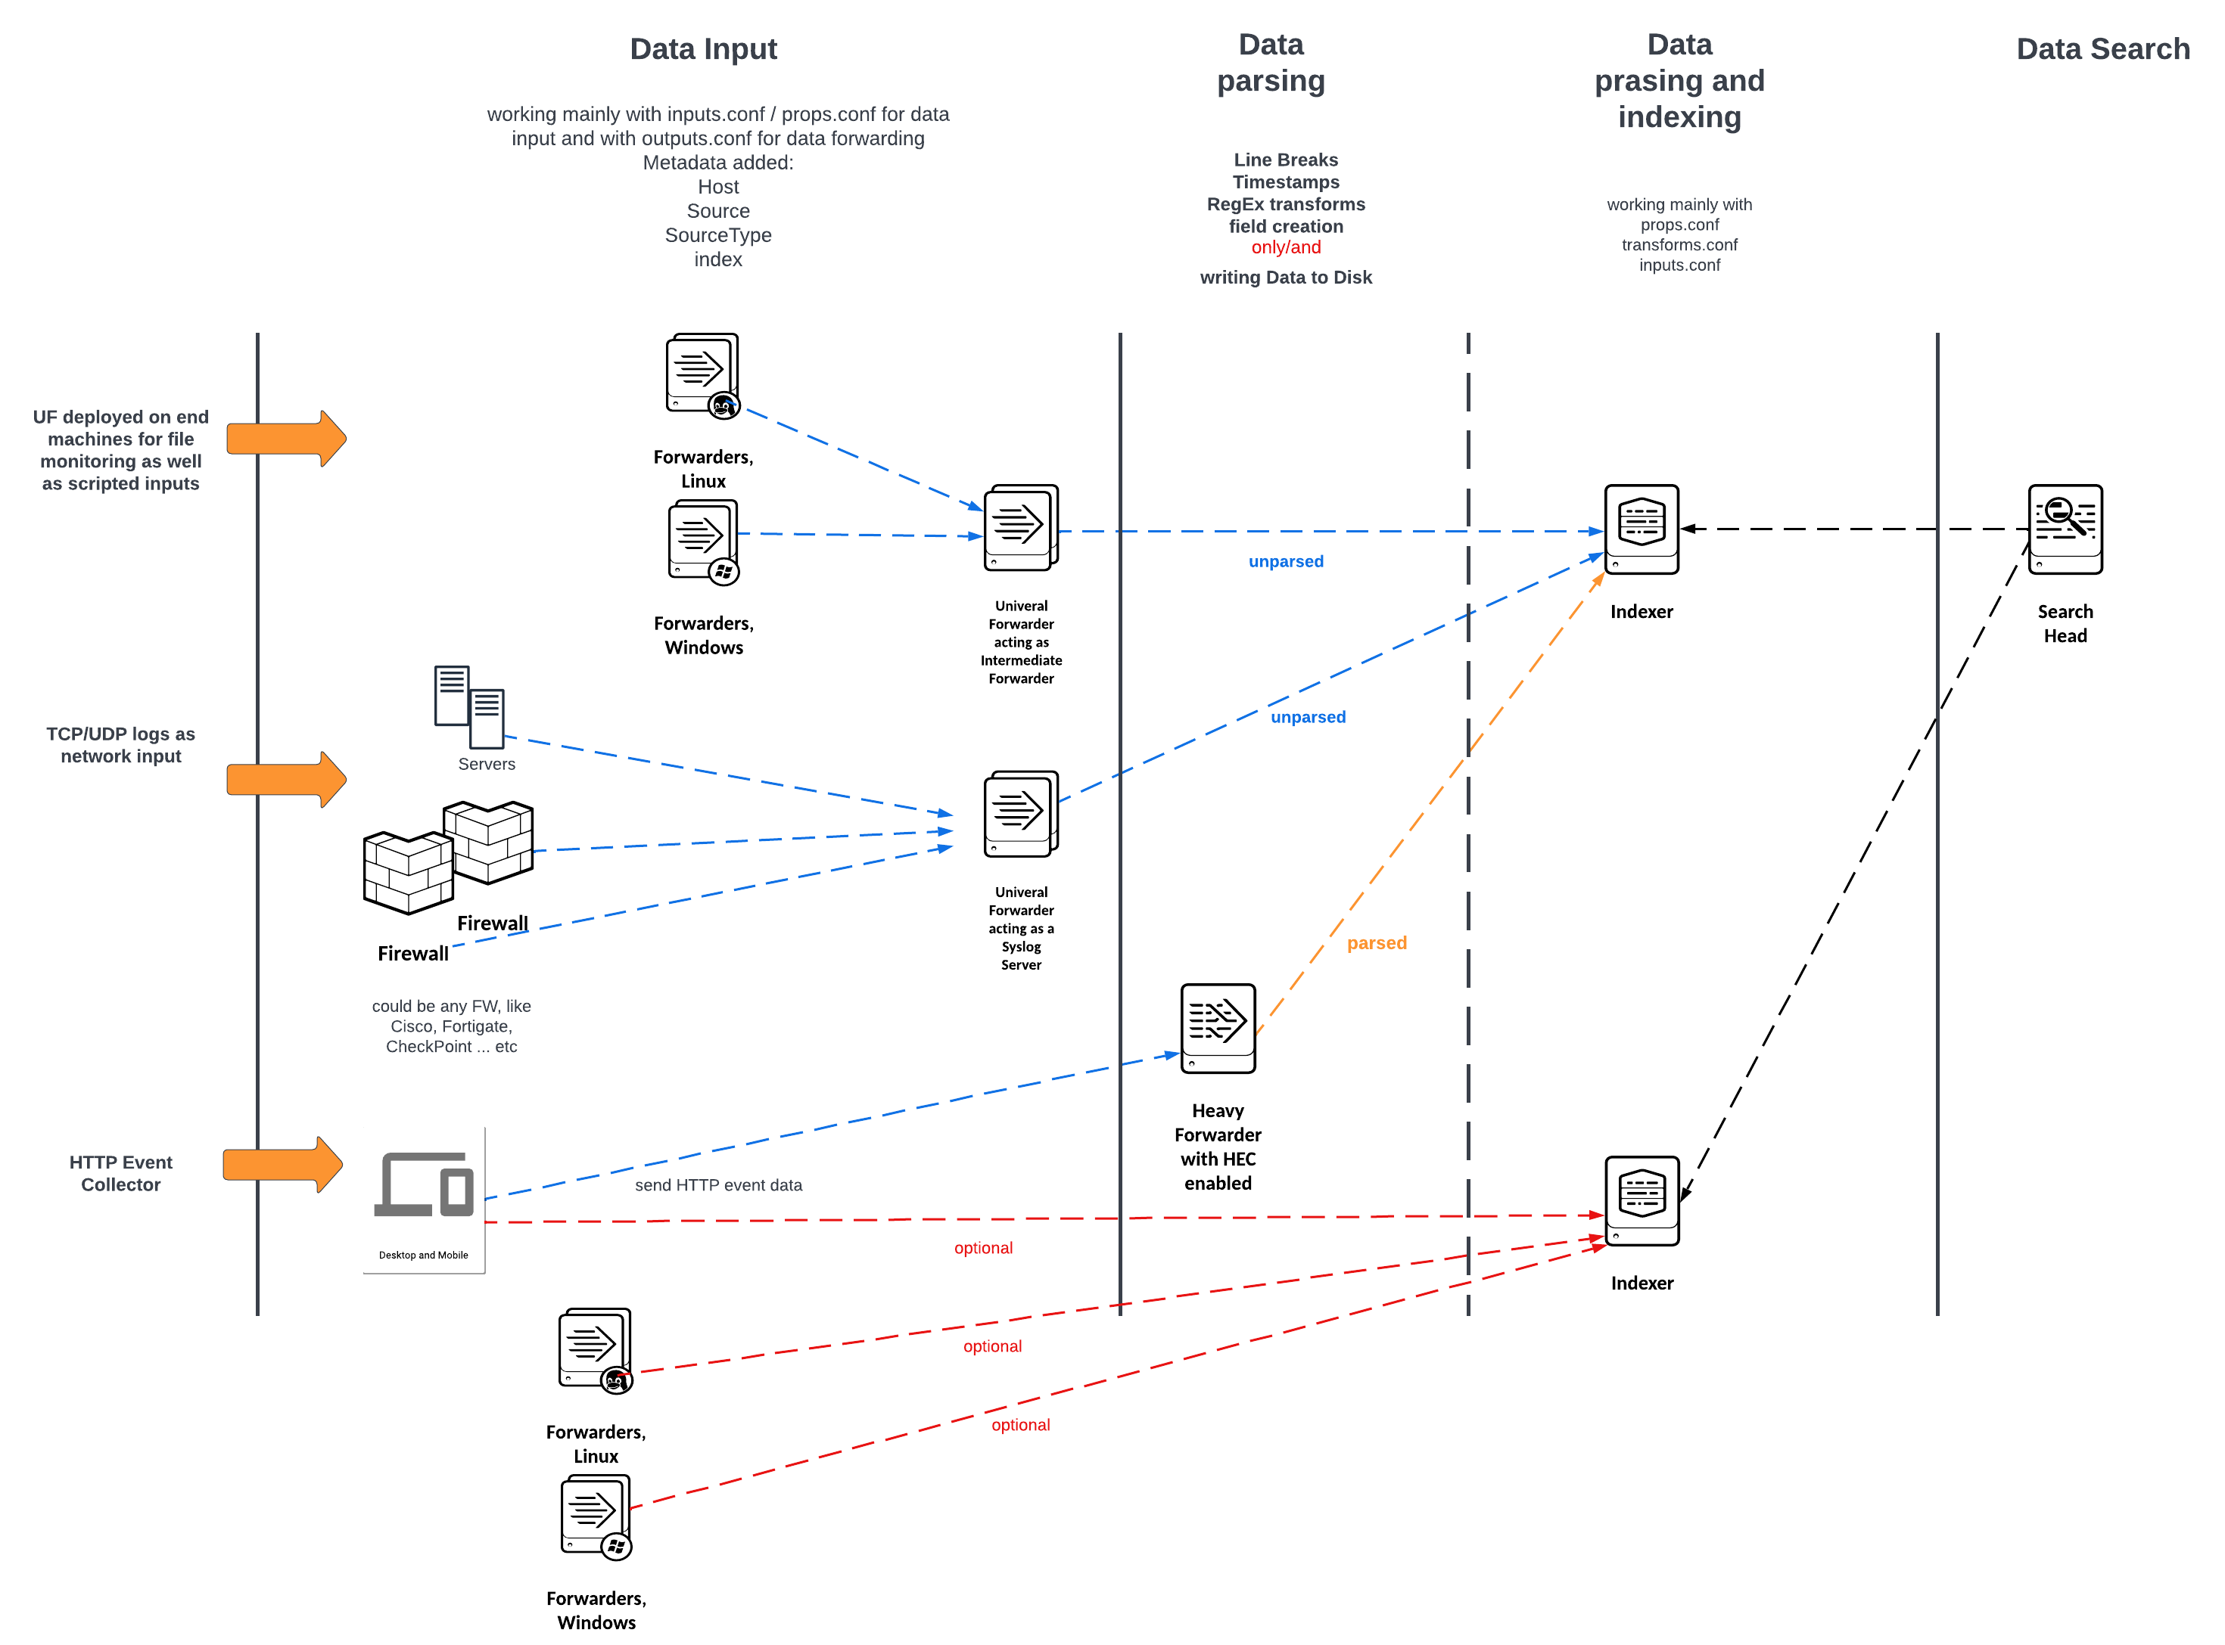
Data Pipeline

Slide 54
MetaData Fields
As Splunk indexes Data, it adds to it some fields automatically and become part of the data
We call these fields as “default fields”
Think of these metadata fields as a way so Splunk can categorize them properly as part of the data ingestion and then search this data at a later stage
Some of the most important default fields are:
Host -----→ the hostname of the machine sending this data as part of the data input ( like a Universal Forwarder )
Source -----→ the originating file name where this data is present when being monitored or the full path to this file or for data sent via syslog, it could be the protocol and the port
Sourcetype -----→ is the way to categorize this data so Splunk can know how to format it ( a reference ) so it is important to assign the correct sourcetype
Index -----→ where this data is destined for ( default “main” )
Timestamp -----→ assign a timestamp to the data being ingested, for more info please refer to
https://docs.splunk.com/Documentation/Splunk/9.0.1/Data/HowSplunkextractstimestamps

Slide 55
Why Sourcetype matters?
Before data onboarding it is crucial to define a Sourcetype for the data to be ingested
Sourcetype controls how Splunk formats the data by applying appropriate set of controls to correctly parse the data into events and allocate timestamp
Splunk comes with a big set of Sourcetypes defined for many different data types, also you can rely on the different Apps / Add-Ons as they are also shipped with preconfigured Sourcetypes serving that data type within that app or Addon
If no Sourcetype is found for your specific data, then you can always create a new one
For more info, please refer to
https://docs.splunk.com/Documentation/Splunk/9.0.1/Data/Whysourcetypesmatter

Slide 56
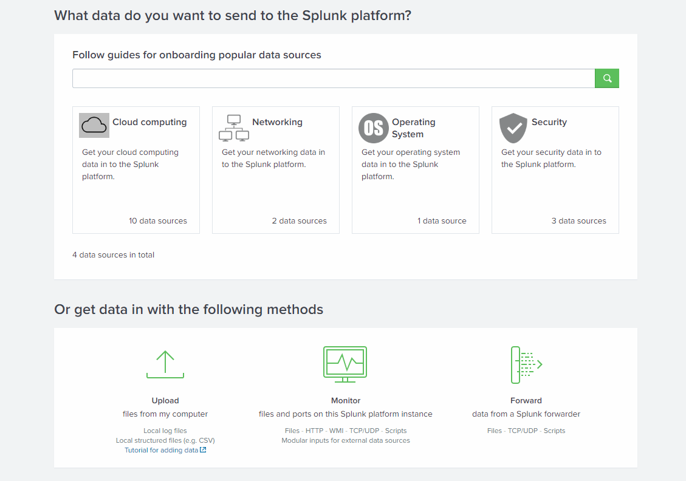
data Input for initial testing

Slide 57
Data Collection Deployment Topology
Edit inputs.conf outputs.conf and props.conf
Define event boundary
Caching / queue size
Indexer acknowledgment
Heavy forwarder cases like masking the data credit cards prior to indexing it!!

Slide 58
Additional controls on UFs
Define event boundary
Caching / queue size
Indexer acknowledgment

Slide 59
Why using a heavy forwarder? Use cases
Advanced level routing
Masking incoming data like credit cards
HEC, Dbconnect
UI is needed ( Ufs don’t have it )

Slide 60
Deployment server why the need?
How to manage large scale deployments? With hundreds of UFs ?
We use the deployment server ( as a central management tool ) to manage configurations and push them to the UFs/HFs which act as deployment clients
It is recommended to deploy the Deployment server on a dedicated Splunk Instance
Management port 8089 both directions
Deployment server pushes the configuration bundles like Apps /Add-Ons or custom configurations like inputs.conf / props.conf or outputs.conf to the deployment clients ( UFs/HFs )
Configurations are pushed from the deployment server under SPLUNK_HOME/etc/deployment-apps directory
Configurations are deployed to deployment clients ( UFs/HFs ) under SPLUNK_HOME/etc/apps directory
Deployment clients poll at time intervals by phoning home back to the deployment server

Slide 61
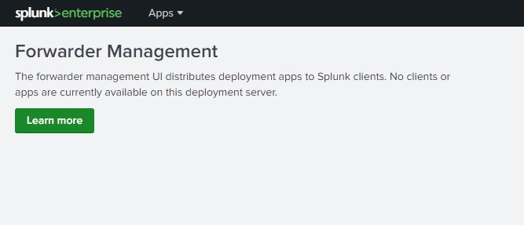
Configure Forward Management
Add Apps under SPLUNK_HOME/etc/deployment-apps
Deploy the deploymenclient.conf to the UFs/HFs to phone home back
To the deployment server
Under the Forwarder Management, create server classes to map
Apps to deployment Clients ( UFs/HFs)

Slide 62
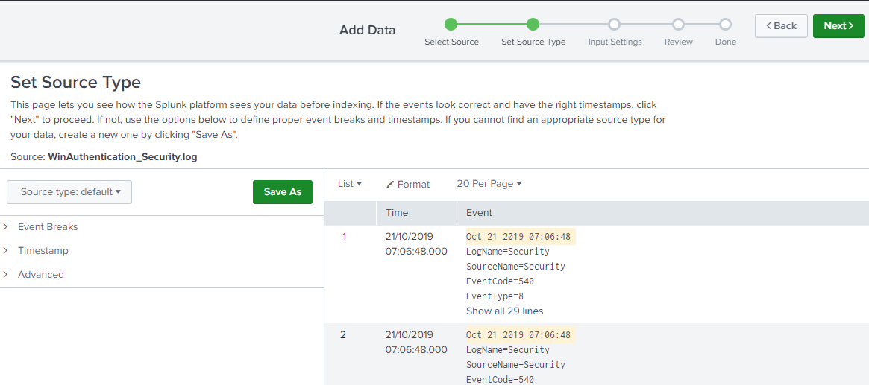
Data Onboarding
Discuss with the customer upfront about the data to be ingested
Prepare a test environment to test your input
Make sure to get the metadata fields (default fields ) correctly from the beginning

Slide 63
Before you onboard the Data
Gather info about the data sources, where is this data and define data collection methodology
Get a data sample
Describe the data structure and discuss interesting fields
Check if a pre-existing app/Add-on for this data is available on splunkbase
Use the Data previewer and use the props / transforms to get this data parsed correctly
Timestamp, event boundary, field extractions … etc
Who can access what?
Define index and retention policy

Slide 64
Things to remember!
Try to set the sourcetype at input phase
If the above is not possible, use props.conf to set the sourcetype using
[source::<PATH_TO_THE_SOURCE>]
Sourcetype = value
[host::<ORIGINATING_HOST>]
Sourcetype = value
If the sourcetype is set at the input phase, you cannot override it in props.conf
you can configure the Source type with additional controls to get the data right at parsing phase like
Line breaking, timestamp extraction, raw data manipulation, fields extractions ..etc

Slide 65
Parsing phase controls in props.conf
SHOULD_LINEMERGE
LINE_BREAKER
TIME_PREFIX
MAX_TIMESTAMP_LOOKAEHAD
TIME_FORMAT
TRUNCATE
TZ
EVENT_BREAKER → only on UF for event boundaries
EVENT_BREAKER_ENABLE → only on UF for activating event boundaries control above

Slide 66
Break 04.20
Host
Index
time

Slide 67
Props.conf Example
[source::/var/log/windows.log]
TRUNCATE = 25000
TZ = UTC
SHOULD_LINEMERGE=false
LINE_BREAKER=([\n\r]+)\w{3}\s\d\d
CHARSET=UTF-8
MAX_TIMESTAMP_LOOKAHEAD=22
disabled=false
TIME_FORMAT=%b %d %Y %H:%M:%S
TIME_PREFIX=^

